Slide 1
Chapter 2
Simulation testing to evaluate estimation performance of a length-based multispecies stock assessment model with different structural assumptions about trophic relationships.

Slide 2
Graphical representation of these models, including inputs and outputs of the model covering equations.
Catch
Catch size comps
Survey index
Survey size comps
Survey diet comps
CV’s and samples sizes
for each variable
Input obs data
100 simulations of times series (52 years) 2 predators, 2 preys, 2 fleets, 1 survey.
OM
Output simulated data
Input sim data
100 runs of Hydra EM, estimates: catch, biomass, effort, etc.
Estimated parameters:
Initial year numbers at size, average annual recruits, annual F, fishery catchability, fishery logistic selectivity at length, survey catchability, survey logistic selectivity at length.
Output
EM
Performance measures
Compare outputs OM EM
Absolut error
Mean quadratic error
Parameter estimation

Slide 3
The simulation model Hydra uses observed data from HydraDataList object to calibrate the model, such as catch, biological data (growth,mortality, etc.), environmental data (temperature, salinity, etc.) and fisheries effort data from different fleets. Also, it uses simulated data such us environmental predictions and growth rates.
To understand the process first:
Step 1: run hydra with Sarah’s files to get the .rep with the estimates (code used to run hydra: ./hydra_sim -ind hydra_sim_GBself_5bin.dat -ainp hydra_sim_GBself_5bin.pin)
Step 2: use the estimates from .rep file and the observed data (cv’s and sample sizes) from hydraDataList (hydra_sim_GBself_5bin.rds) to create my simulations.
Step 3: run the estimation model 100 times with my simulated data.

Slide 4
OM initial_run parametrization (1 survey): Atlantic_cod, Atlantic_herring, Atlantic_mackerel, Spiny_dogfish
Initial N year 1, recruitment_alpha, recruitment_shape, recruitment_beta, ln_avg_recruitment, recruitment_devs: no changes from Sarah initial files
ln_avg_recruitment: 5, 10, 7.5, 5 (148.4, 22026.5, 1808, 148.4)
ln_recsigma: -0.69, -0.69, -0.69, -2.3 (0.5, 0.5, 0.5, 0.1). Recruitment for dogfish less changes (small values)
Fleet one: primary species Cod: high F values first 20 years
Fleet two: primary species Herring: keep it constant
avg_F, 1:fleets: fleet 1 demersal fleet 2 pelagic -0.693147181, -0.693147181 (0.5, 0.5)
Annual deviations demersal first 20 year 0 second half -0.9 (0.41), Annual deviations pelagic constant in 0
fishsel_pars 1,1,1,1 same as original data sets
ln_fishery_q dogfish: -1.39 (0.25 ) and mackerel: 0.40 (1.5)
Other food 21 (1.318.815.734)
other food devs: 0,0,0
M1: -2.3025851 -1.0498221 -1.6094379 -2.3025851 (herring 0.35 and mackerel 0.2 and 0.1 for cod and dogfish)
Disabled the estimation phase for F and deviations to force the trend that I need. F and deviations are fixed parameters

Slide 5
OM scenarios
Other food high
Other food low

Slide 6
Summary first slide
OM: I use the OM to experiment with different scenarios and to evaluate the dynamics under the specific assumptions or scenarios.
EM: I use the EM to fit the model parameters to the observed data (simulated in this case) to get stock status predictions.
Outputs from both models OM and EM such as biomass, effort, spawning biomass, etc.
Compare outputs: use the outputs from each model (estimation and simulation) to compere similarities and differences. Use measures such as absolut error and mean quadratic error for each scenario.
Sensitivity analysis: differences in the estimated parameters for each model and scenario to evaluate sensitivity of predictions.

Slide 7
Questions from first slide
OM: if I am going to use my OM to generate data under different scenarios is it here where I must adjust the parameters such as other food and M1?
For example, I ran the OM in step 1 (slide 2) and I already created the sim data (using the HydraDataList from Sarah and the .rep file in step 2), then I used these simulations to run the EM, my question is in which step do I have to change OF and M1 values. I am doing it in the .rep file, before I generate the simulated data. So, my 100 rep files are going to have the impacts of changing those params.
EM: I use the EM to fit the model parameters to observed data (simulated data in this case) to get stock status predictions.
I am reserving variables such as effort, catch, spawning biomass, etc to compare the EM and OM estimates.
Data and codes available in this folder

Slide 8
Compare the estimates from the 100 simulations with the values from the operating model.
Outputs from OM 1 survey 4 species
plots
Outputs from EM simulated data
Rep files
Par files
With all this information I am working in the chapter 2 document, what I have so far (link)

Slide 9
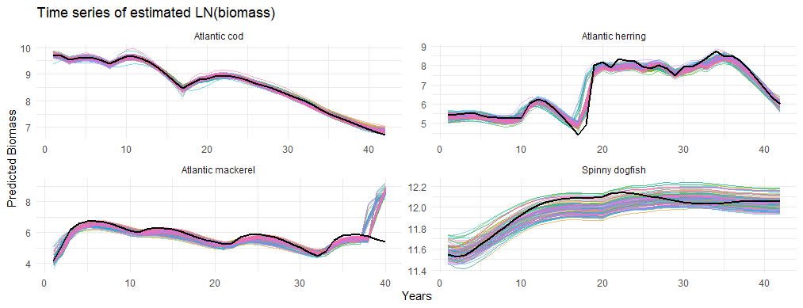
Plots comparisons from OM and EM
Figure x Time series of estimated biomass from EM with 100 simulations (colored lines ) and OM (black solid line)

Slide 10
What are the time series to fit the emulators and what are the dimensions? With these we can determine which is the best method to apply.
Chapter 3: to test different machine learning methods we are going to use times series from Hydra using the pMSE 10 species base model to create series of catch, biomass, spawning biomass, fishing effort, etc. These time series are going to be used to train and test the emulators. Dimensions for each variable number of species, number of simulations and years of projection.
data sets from
pMSE base operating model
Projection with constant F
Chapter 4: to evaluate different management scenarios we are going to use time series from Atlantis NEUS, including different spatial allocation of effort for the different fleets and species. The idea is to determine if the emulator is able to capture these differences in allocations.
data sets from
Atlantis NEUS

Slide 11
Methods discussion will benefit, the emulator will try to emulate. Unclear about the scenarios in chapter 3.
Scenarios in chapter 3 will be based on the spatial distribution of catch allocations and effort.
How fishing communities change over time due to historic catch and effort allocation in a community-based approach. This way we can evaluate for example how yield changes in different communities due to management actions (smaller scale evaluation).
Scenarios: set of management strategies
1st status quo (single species MSY) to compare other scenarios to actual management
Different fishing efforts for communities-at-sea, reducing effort in overfishes stocks or maximize economic yield.
Varying fishing effort in different fleets (gears)

Slide 12
Problem statement, unpacking to understand the direction of the dissertation and objectives.
Chapter 2: The objective of this chapter is to evaluate the performance of Hydra multispecies estimation model, assessing its performance and its ability to reproduce multispecies and multifleet population dynamics based on lengths. The answer we seek is whether the model can replicate the population and fishing patterns of the study area. To do this, we will evaluate how the data on the composition of the predator diet affects the performance of the estimation model (important since it is a model that includes interactions between species). Evaluating how the assumptions about interactions between species affect the performance of the model will help us to better understand the uncertainty in multispecies assessments, and better representing the reality of the ecosystem. The utility of this chapter is to provide a robust tool for fisheries management following an ecosystem approach, including the interaction between species and fleets in the management objectives.

Slide 13
Chapter 3: The objective of this chapter is to apply methods such as Recurrent Neural Networks, specifically Long Short-Term Memory as statistical emulators to model ecosystem dynamics in an ecosystem approach. As a specific objective, we will evaluate the capacity of statistical models to emulate and predict population dynamics using Hydra to generate data series to train and test the emulator. The usefulness of this chapter is to improve efficiency in terms of simulation since the emulator is capable of processing large amounts of data more quickly, allowing the evaluation of various fisheries management scenarios and the impacts that these can have on users and the ecosystem. LSTM has the ability to remember temporal dependencies, which is especially useful when working with time series, making the emulator accurate in emulating current trends but also in future predictions.

Slide 14
Chapter 4: The objective of this chapter is to use the emulators chosen in the previous chapter to evaluate different fisheries management strategies at the level of coastal fishing communities, helping us to understand how management affects these communities not only by optimizing the ecological impact but also the economic one. For this we will use data series from Atlantis NEUS, which includes small-scale fisheries dynamics, including various management scenarios (catch and effort allocations). These simulated data correspond to time series of biomass, effort, catch composition, biological indicators such as overfished or important species for the ecosystem and economic indicators. These data are divided into training groups (70%), validation (15%) and test (15%). Later, the emulator must be designed (number of layers and neurons), the emulator parameters must fit to the training data and to minimize difference between the emulator predictions and the data. The model must be validated using the validation set. Finally evaluate the emulator performance with the test data for each scenario.
Root Mean Square Error (RMSE), the Mean Absolute Error (MAE) to measure accuracy. Compare results from both models to assess precission and cross-validation to assess sensitivity.
Deploy the model: use the statistical model to emulate new management scenarios

Slide 15
Add one slide about hydra, what are the inputs and the parameters, and the performance measures.
Inputs:
.dat file
Includes number of fleets, surveys, years, species, size bins, areas, growth parameters, recruitment params, maturity params, fecundity params, effort, stomach content in weight, bottom temperature, vulnerability, prey/predator preference ratio, equilibrium biomass, other food value,
-ts.dat file
Includes time series of survey abundance, time series of catch, time series of survey diet composition, time series of survey and catch size composition
.pin file
Initial parameters: initial abundance, recruitment parameters, average recruitment and deviations, average F and deviations, vulnerability, fishery and survey selectivity and catchability, natural mortality M1, other food value and deviations.
Performance measures: parameter estimation, comparison between observed and predicted values, objective function value, confidence intervals.

Slide 16
Be more specific in the performance measures and particular methods
Sitting down, plot your models and methods, think and draw.
For chapter 3 and 4 we have the data sets to test and validate the model. Also, Root mean squared error that penalized larger errors; Mean absolute error: average the magnitude of errors (average of the differences between predicted and observed values); Mean absolute percentage error.
Also, we can use the measures generally used in machine learning such as accuracy, precision and sensitivity.
F1 score and AUC-ROC
To measure robustness: cross validation metrics and hyperparameter sensitivity

Slide 17
Work plan Hydra chapter
What do I need before starting the analysis
Conditioned OM
What are the outputs that I want from my OM, same time series from stock assessment reports or something different?
Once I have my OM
What do I need: scenarios, how many?
Varying OF and M1
Once I have my scenarios
Run the simulations
Once I have the outputs
Plots outputs from OM and EM
Compare parameters estimated

Slide 18
What do I need to explain in detail in my document
Hydra OM equations and fixed parameters
Hydra OM input data?
Scenarios
EM likelihoods?
Estimated parameters

